Slide 1

A framework for predicting the impacts of rabies control and prevention strategies
Martha Luka
12/02/2024
Katie Hampson | Dan Haydon | Elaine Ferguson
m.luka.1@research.gla.ac.uk

Slide 2

Roadmap
INTRODUCTION
DECISION TREE MODEL
IMPACTS OF POLICY CHOICES
HUMAN VACCINES
Zero by 30 goal
Research aims
Rabies interventions
Model framework
Key interventions
Intradermal vaccines
Free human vaccines
MDV
Dissemination
Vaccine supply
Gavi opportunity

Slide 3
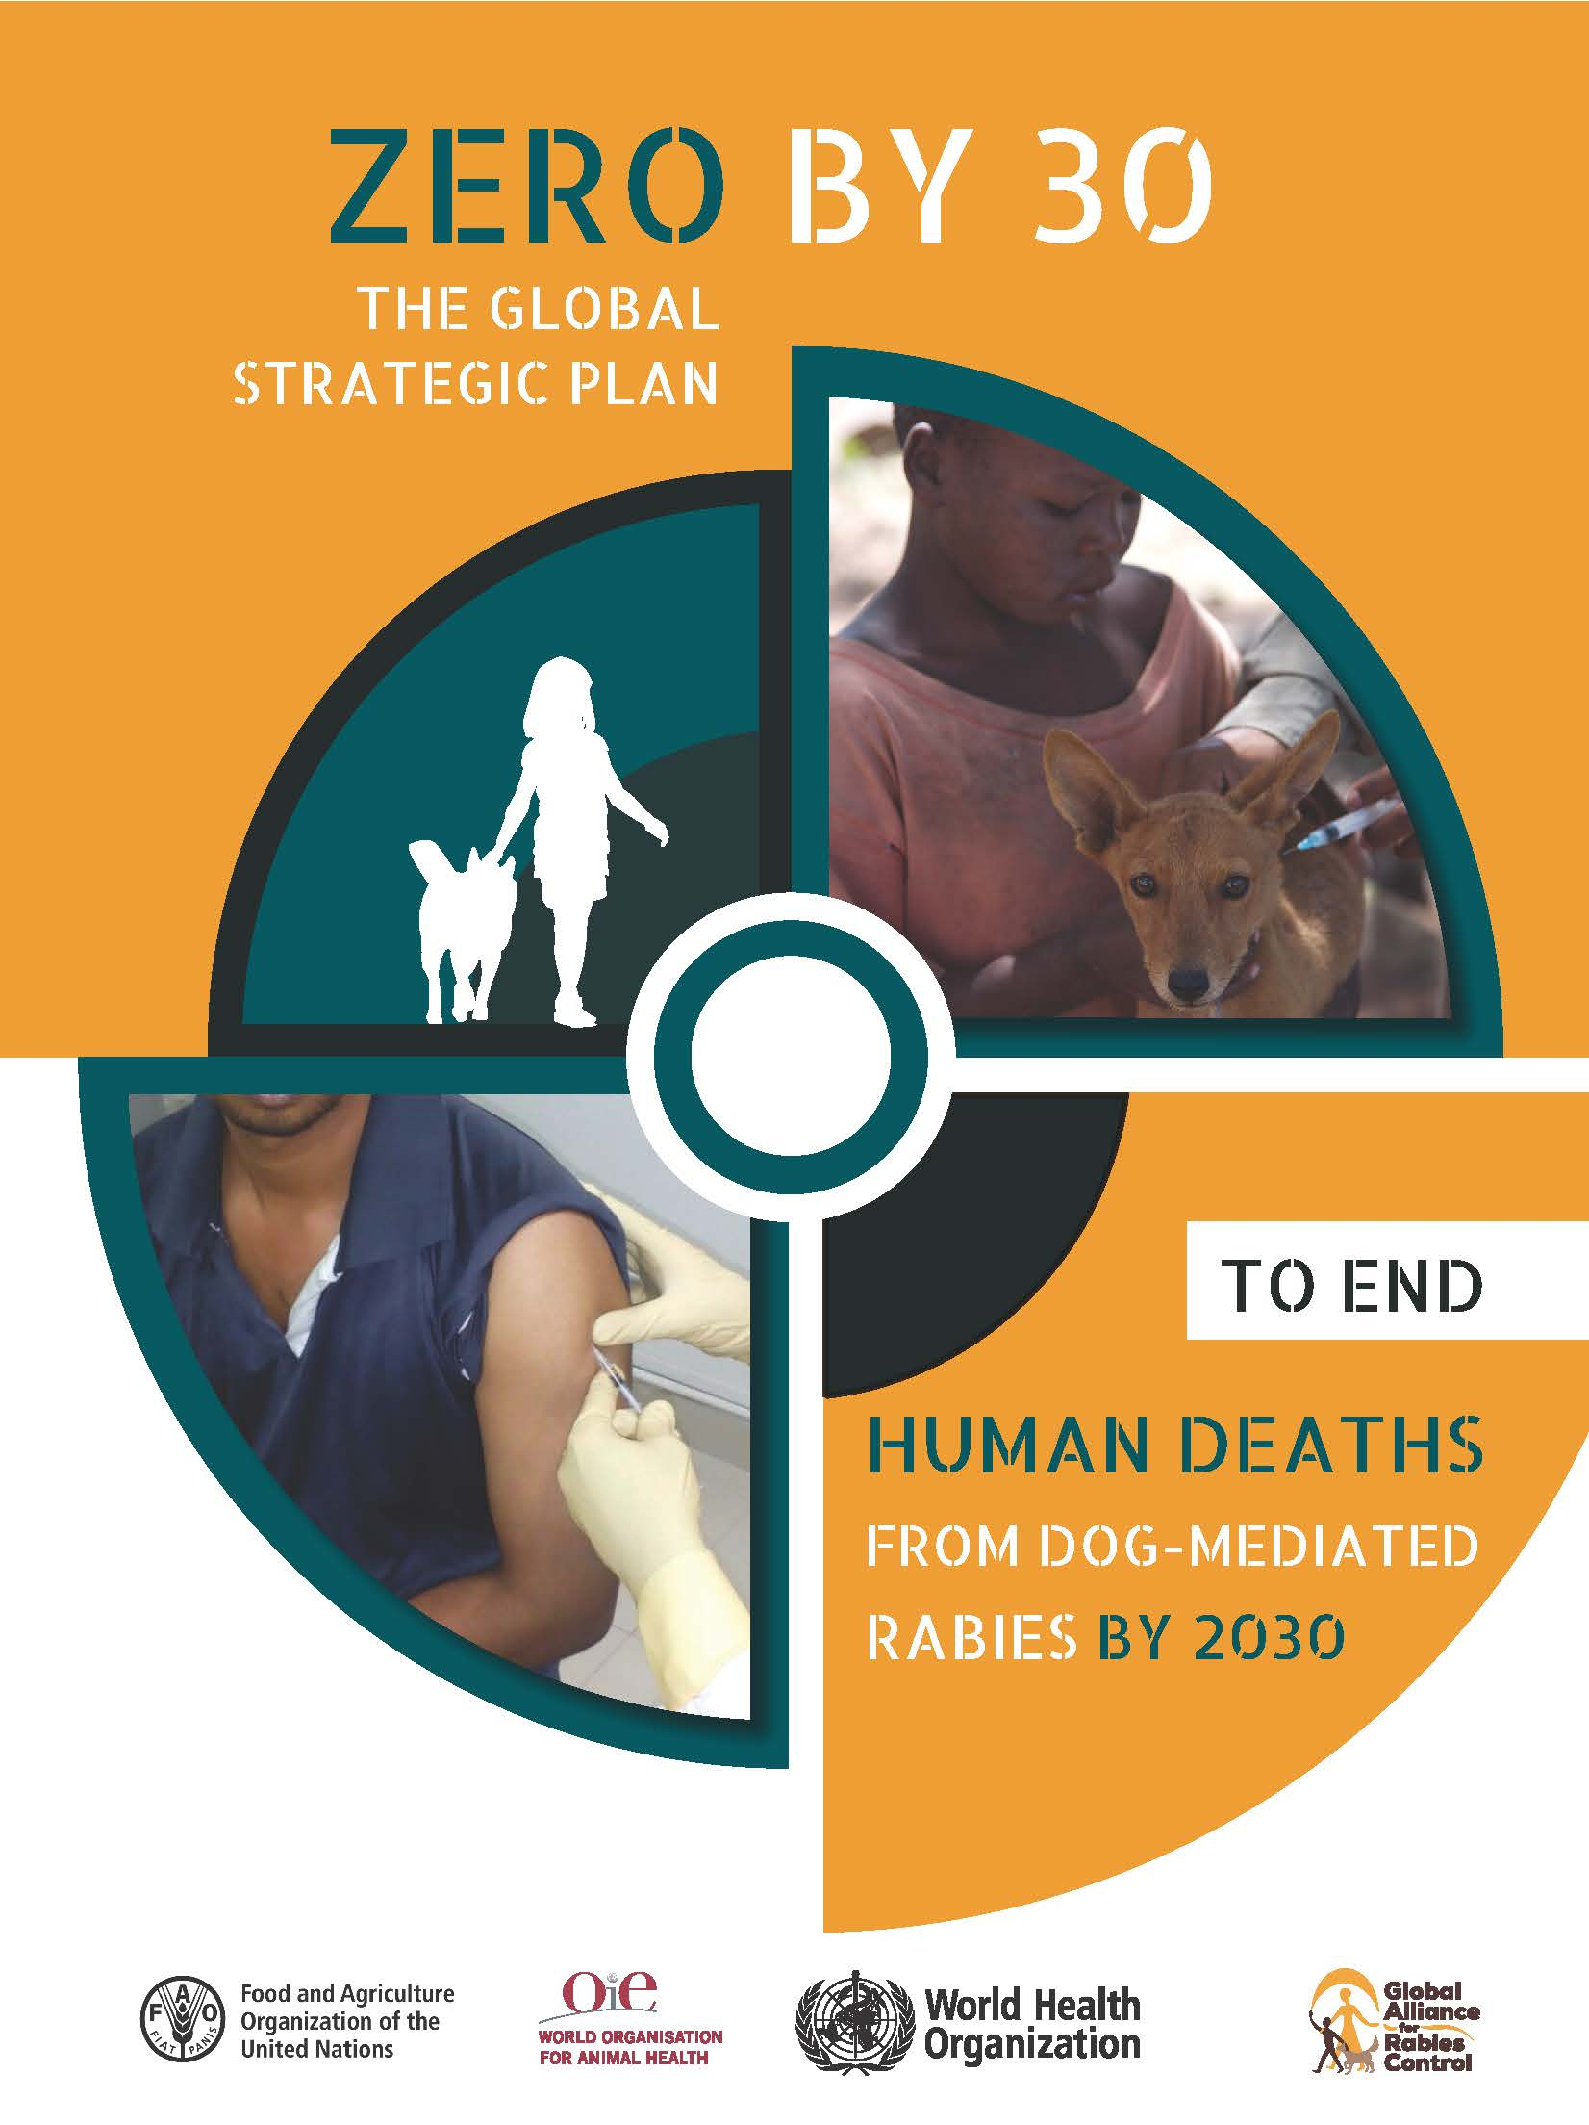
Zero by ‘30
There are concerted efforts to eliminate human rabies by 2030
Recognizes that rabies is a preventable disease
Key interventions:
mass dog vaccination (MDV)
post-exposure prophylaxis (PEP)
Impacts of interventions not examined across populations to support planning
Notes:
Have not been parametrized, mapped, and used predictively examine the potential impacts of prevention strategies on rabies control

Slide 4
Research Aims
To develop a decision tree model to inform regional coordination and policy on human rabies elimination
To develop a framework to support stakeholders in planning rabies surveillance and prevention
To develop a model to support a robust human rabies vaccine supply chain management
To understand the role of geographical connectivity in achieving and maintaining rabies freedom
Notes:
Number 4 – falls within aim of the workshop – to establish genomics as a tool for rabies surveillance and monitoring.
Rabies could be speading between states. What actions need to be coordinated across states and with neighbouring countries, ie as a block?

Slide 5
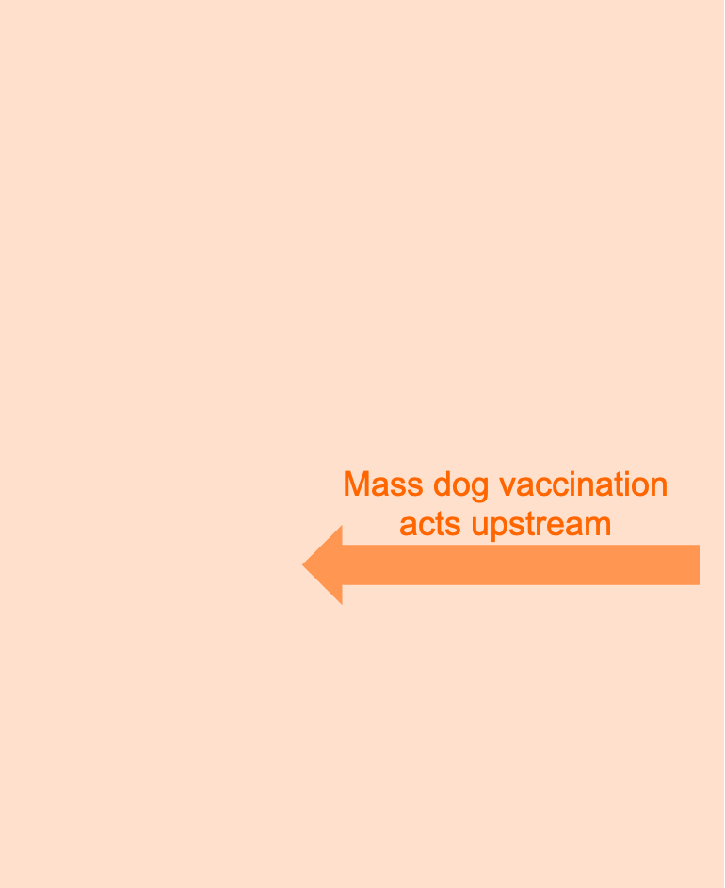
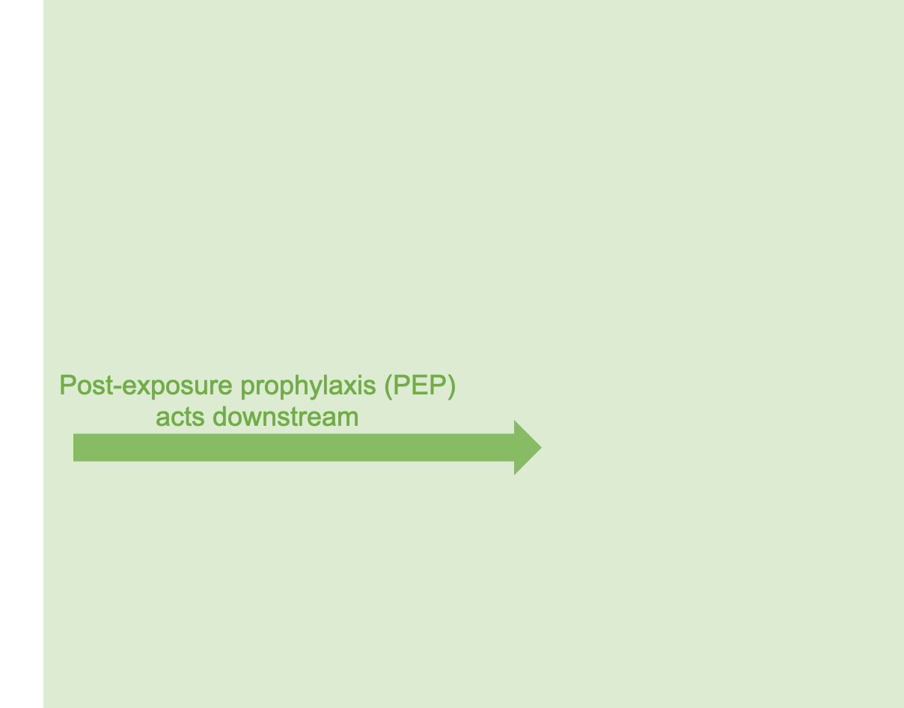
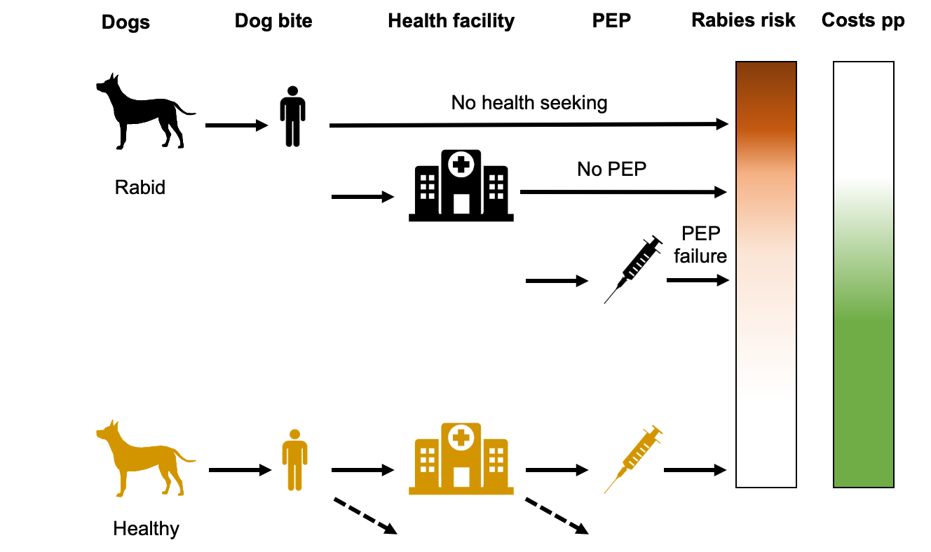
Rabies interventions
Notes:
in Tanzania, where patients pay for PEP, only 1/5 of rabid bite victims go to a hospital for care bc the costs are too dear.
ID admin can cushion these costs
Making PEP free of charge with help of Gavi investment
Scaling up MDV

Slide 6
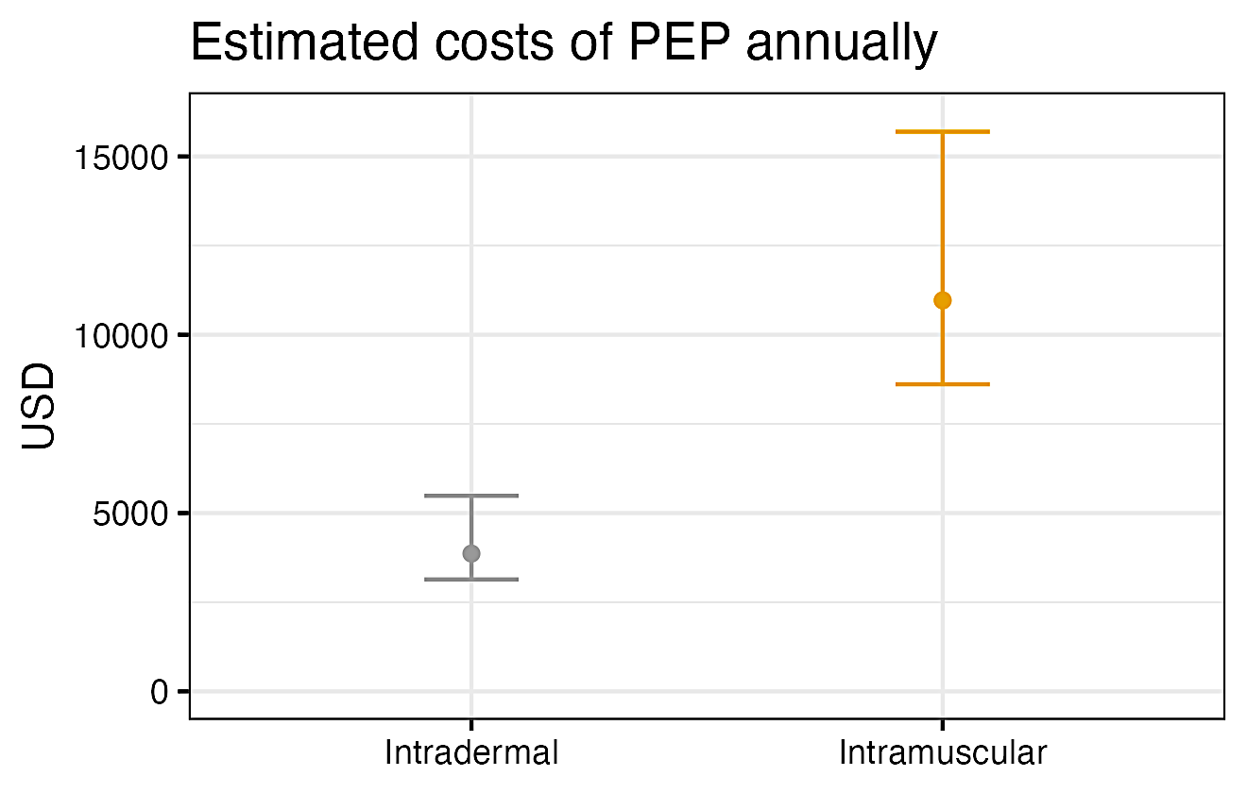
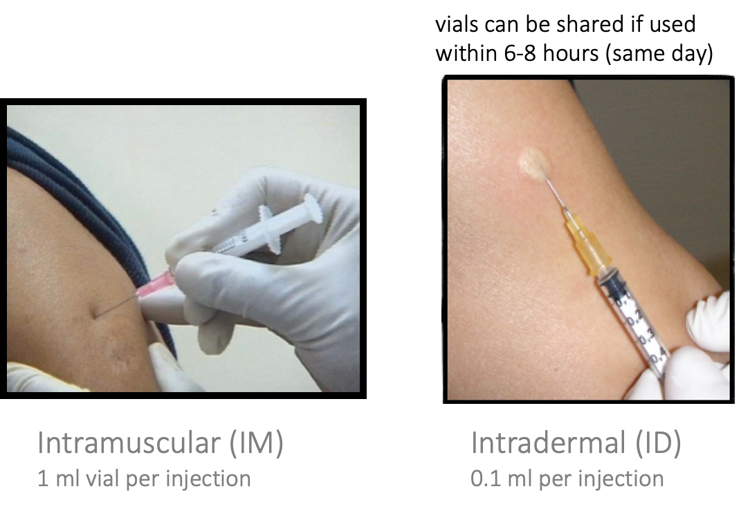
1. Intradermal vaccines are cost-saving
Intramuscular (IM)
1 ml per injection
Intradermal (ID)
0.1 ml per injection
Economic impacts of ID vs IM PEP admin in Pemba island.
ID admin allows for vial sharing, making it potentially cost-effective
Notes:
Pemba – annual numbers

Slide 7
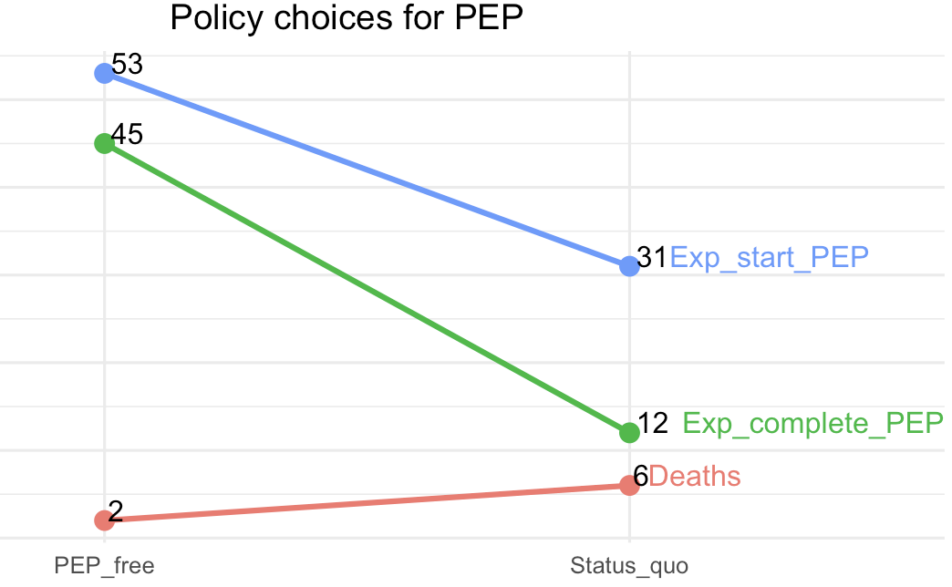
2. Free vaccines improve health seeking
With free PEP, more people seek care, initiate and complete PEP after an exposure

Slide 8
3. MDV is effective in reducing high risk bites
Exposures
Time-series predictions of human exposures in Pemba island over a 7-year period, given 70% MDV implementation
Implementing MDV following an introduction results in decline of rabies cases in 3-7 years
Notes:
Achieved in Pemba, but resurgence once MDV efforts declined.

Slide 9
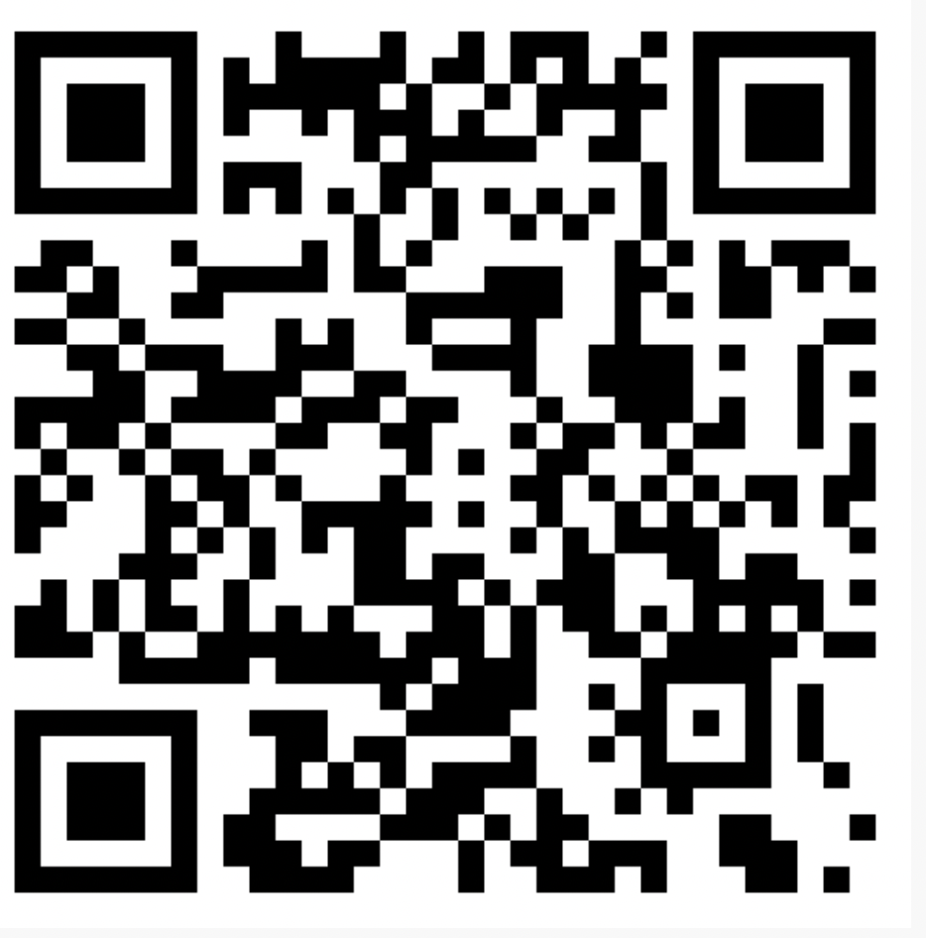
Decision tree model
Next steps:
Refine functions
Package this into an interactive online app
researchers
stakeholders
Framework for different settings
bit.ly/3rWcMqm
Notes:
We are taking this modeling framework and developing it into a planning tool - this is a work in progress but …
Is this the kind of tool you see yourselves using to plan rabies control? Take a look at the QR code and I welcome feedback ☺

Slide 10
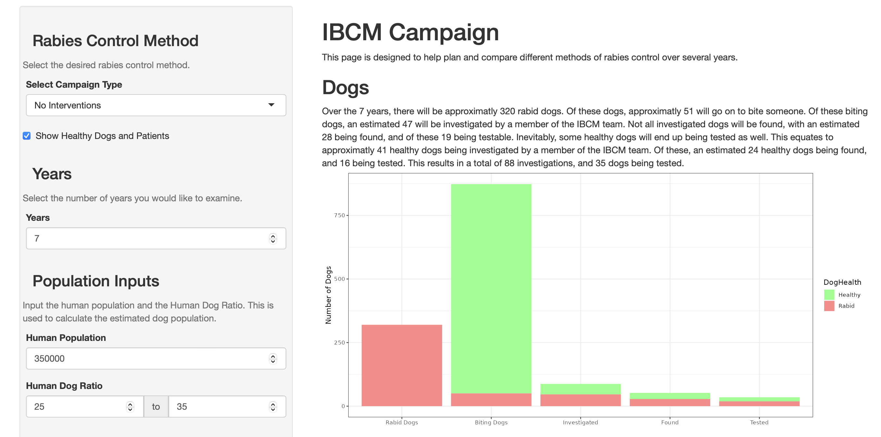
Web interface for planning IBCM implementation

Slide 11
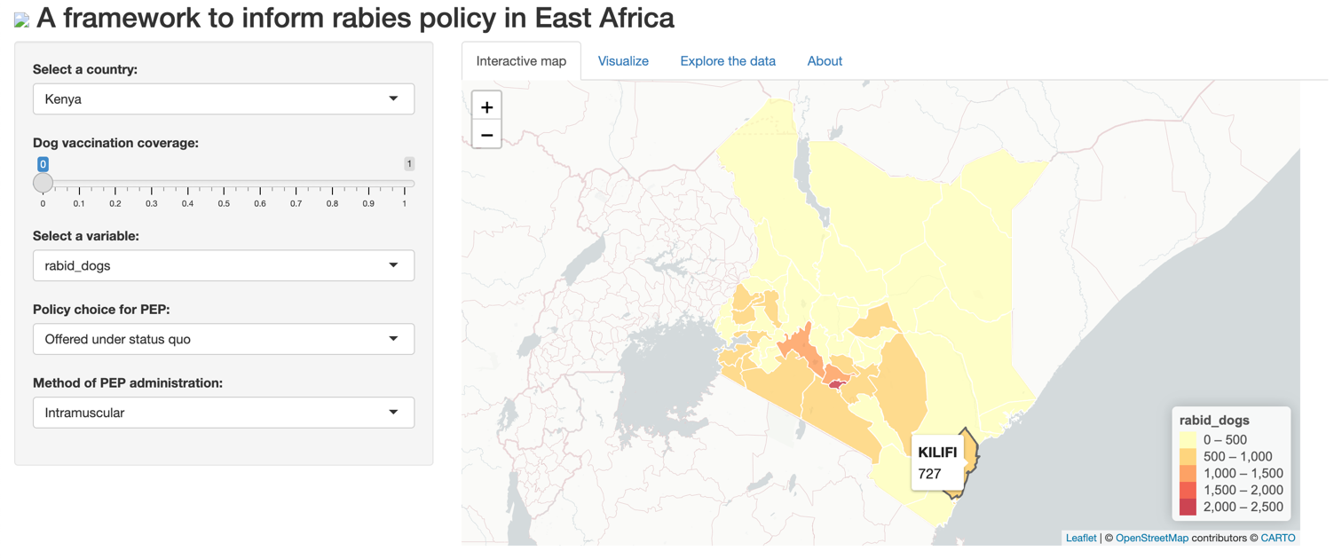
Dashboard for forecasting policy impacts

Slide 12
Roadmap
INTRODUCTION
DECISION TREE MODEL
IMPACTS OF POLICY CHOICES
HUMAN VACCINES
Zero by 30 goal
Research aims
Rabies interventions
Model framework
Key parameters
Sensitivity Analysis
Intradermal vaccines
Free human vaccines
MDV
Dissemination
Vaccine supply
Gavi opportunity

Slide 13
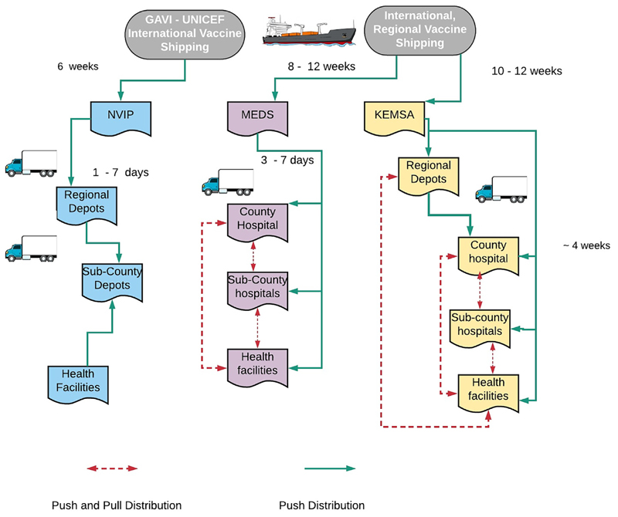
Human vaccine supply chain
Rabies currently not part of the expanded program on immunization (EPI)
Delays in procurement therefore vaccine stockouts
Modelling approaches:
Understand the implications of stocking at different levels
Quantify appropriate minimum stock thresholds
Wambura et. al., 2019
Notes:
Appreciate that Nigeria may be different
National Vaccine Immunization Program (NVIP) Mission for Essential Drugs and Supplies (MEDS) Kenya Medical Supplies Agency (KEMSA)
NVIP is responsible for all the routine vaccines used in the Expanded Program for Immunization (EPI), whereas KEMSA and MEDs mainly support medical supplies including non-routine vaccines for public and private health facilities respectively.
Quantify appropriate minimum stock thresholds that can enhance the readiness and capacity of healthcare facilities to respond promptly in the case of a resurgence

Slide 14
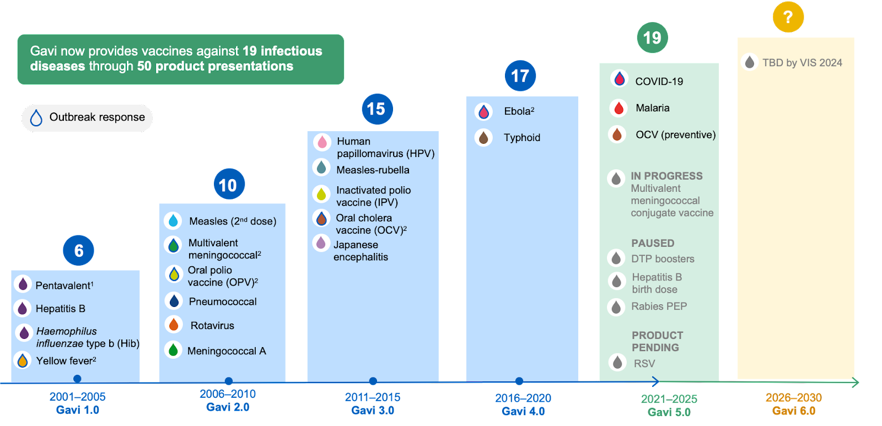
Gavi’s portfolio has grown over time & added rabies PEP from 2021
gavi.org

Slide 15
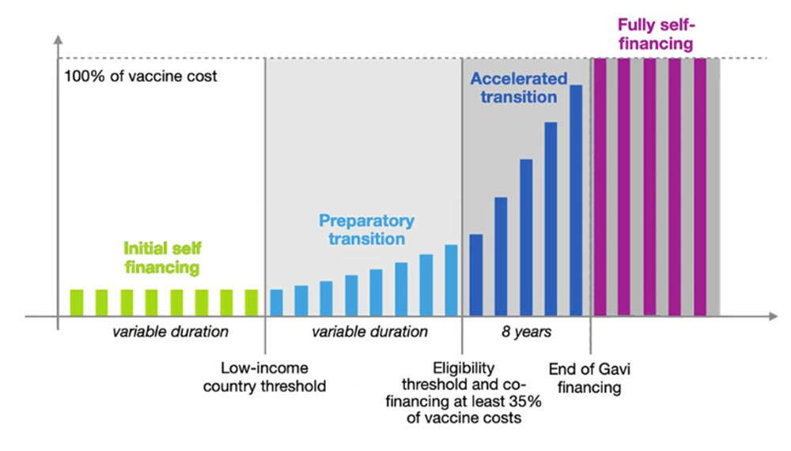
Gavi eligibility
Eligibility for Gavi support determined by countries' national income
Nigeria
Kenya
Uganda
Tanzania
gavi.org
Notes:
Gavi’s portfolio has grown over time & added rabies PEP from 2021
KE in a “funny place”
However, there is still a real opportunity for Kenya – bring in training & support; This will also help KE tap into other resources on dog vaccines
Next steps: How would countries stock/ distribute vaccines

Slide 16
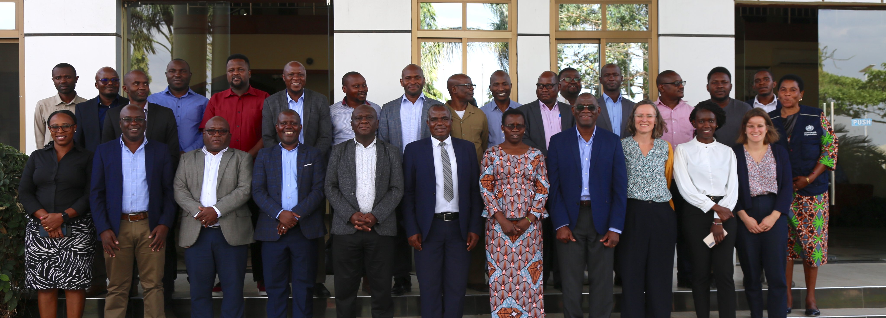
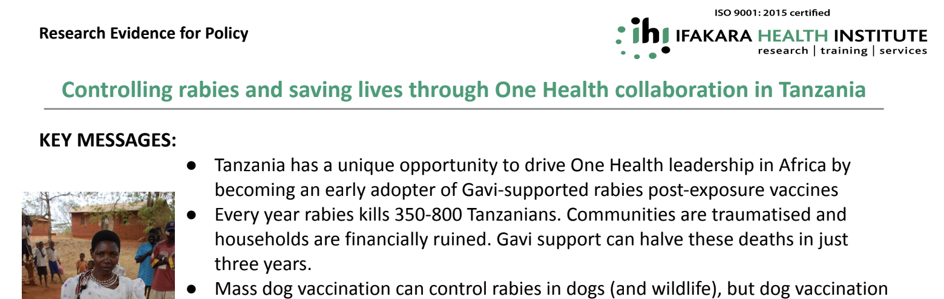
The conversation is happening…

Slide 17
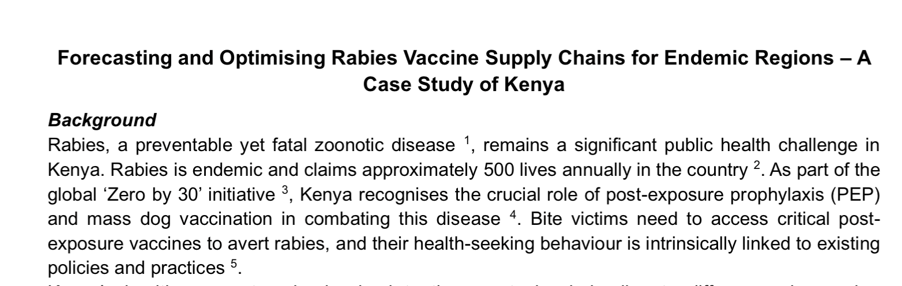
The conversation is happening…
Notes:
We are working with colleagues from Kenya who as part of the national strategy, are thinking of how to co-ordinate vaccine rollout. This is taking into account the diversity across the country.

Slide 18
The conversation is happening…
Nigeria?

Slide 19
Summary
Understanding of the key determinants underlying rabies burden has improved considerably
MDV single most effective approach to achieve zero human cases
Free PEP will result in increased healthcare - seeking
PEP alone cannot achieve zero human deaths – crucial in areas with high incidence
Countries have the opportunity to take advantage of Gavi’s investment
Addressing the objectives of this study will
Inform stakeholders on the incremental cost effectiveness of different interventions
Support stakeholders to create a framework to achieve & maintain human rabies freedom
Notes:
Gavi investment

Slide 20
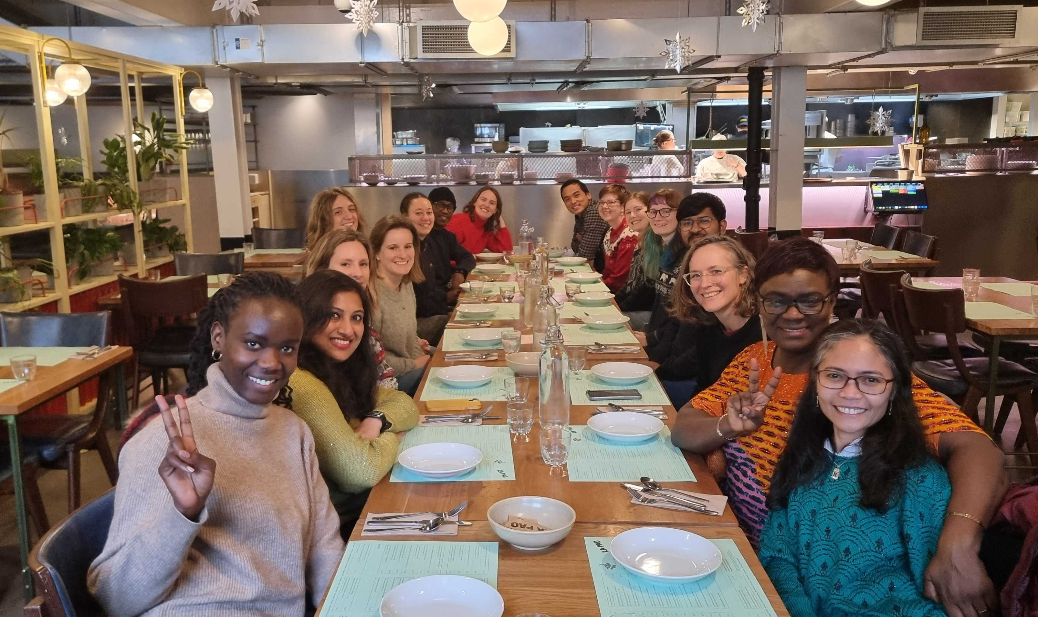






Thank you
m.luka.1@research.gla.ac.uk
@martha_mawia

